Slide 1
Enhancements to basic decision tree induction, C4.5

Slide 2


Slide 3

This is a decision tree for credit risk assessment
  It classifies all examples of the table correctly

Slide 4
ID3 selects a property to test at the current node of the tree and uses this test to partition the set of examples
The algorithm then recursively constructs a sub tree for each partition
This continuous until all members of the partition are in the same class
    That class becomes a leaf node of the tree

Slide 5
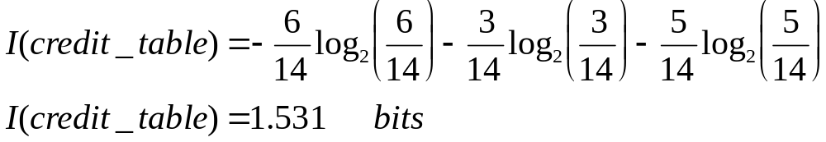
The credit history loan table has following information
  p(risk is high)=6/14
  p(risk is moderate)=3/14
  p(risk is low)=5/14

Slide 6
gain(income)=I(credit_table)-E(income)
gain(income)=1.531-0.564
gain(income)=0.967 bits
gain(credit history)=0.266
gain(debt)=0.581
gain(collateral)=0.756

Slide 7
Overfiting
Reduced-Error Pruning
C4.5
  From Trees to Rules
  Contigency table (statistics)
continous/unknown attributescross-validation

Slide 8
Overfiting
The ID3 algorithm grows each branch of the tree just deeply enough to perfectly classify the training examples
Difficulties may be present:
  When there is noise in the data
  When the number of training examples is too small to produce a representative sample of the true target function
The ID3 algorithm can produce trees that overfit the training examples

Slide 9
We will say that a hypothesis overfits the training examples if some other hypothesis that fits the training examples less well actually performs better over the entire distribution of instances (included instances beyond training set)

Slide 10
Overfitting
Consider error of hypothesis h over
Training data: error_{train}(h)
Entire distribution D of data: error_{D}(h)
Hypothesis h∈H overfits training data if there is an alternative hypothesis h’∈H such that
error_{train}(h) < error_{train}(h’)
and
error_{D}(h) > error_{D}(h’)

Slide 11
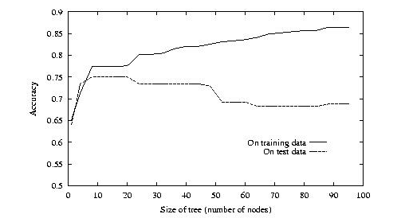
Overfitting

Slide 12
How can it be possible for a tree h to fit the training examples better than h’
But to perform more poorly over subsequent examples
One way this can occur when the training examples contain random errors or noise

Slide 13
Training Examples
Day | Outlook | Temp. | Humidity | Wind | Play Tennis
D1 | Sunny | Hot | High | Weak | No
D2 | Sunny | Hot | High | Strong | No
D3 | Overcast | Hot | High | Weak | Yes
D4 | Rain | Mild | High | Weak | Yes
D5 | Rain | Cool | Normal | Weak | Yes
D6 | Rain | Cool | Normal | Strong | No
D7 | Overcast | Cool | Normal | Weak | Yes
D8 | Sunny | Mild | High | Weak | No
D9 | Sunny | Cold | Normal | Weak | Yes
D10 | Rain | Mild | Normal | Strong | Yes
D11 | Sunny | Mild | Normal | Strong | Yes
D12 | Overcast | Mild | High | Strong | Yes
D13 | Overcast | Hot | Normal | Weak | Yes
D14 | Rain | Mild | High | Strong | No

Slide 14
Decision Tree for PlayTennis
Outlook
Sunny
Overcast
Rain
Humidity
Yes
Wind
High
Normal
Strong
Weak
No
Yes
No
Yes

Slide 15
Consider of adding the following positive training example, incorrectly labaled as negative
Outlook=Sunny, Temperature=Hot, Humidty=Normal, Wind=Strong, PlayTenis=No
The addition of this incorrect example will now cause ID3 to construct a more complex tree
Because the new example is labaled as a negative example, ID3 will search for further refinements to the tree

Slide 16
As long as the new errenous example differs in some attributes, ID3 will succeed in finding a tree
ID3 will output a decision tree (h) that is more complex then the orginal tree (h‘)
Given the new decision tree a simple consequence of fitting nosy training examples,h‘ will outpreform h on the test set

Slide 17
Avoid Overfitting
How can we avoid overfitting?
  Stop growing when data split not statistically significant
  Grow full tree then post-prune
How to select ``best'' tree:
  Measure performance over training data
  Measure performance over separate validation data set

Slide 18
Reduced-Error Pruning
Split data into training and validation set
Do until further pruning is harmful:
  Evaluate impact on validation set of pruning each possible node (plus those below it)
  Greedily remove the one that most improves the validation set accuracy
Produces smallest version of most accurate subtree

Slide 19
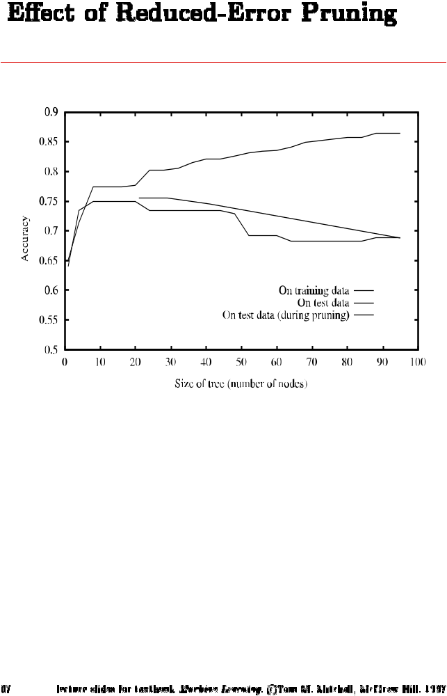
Effect of Reduced Error Pruning

Slide 20
Rule-Post Pruning
Convert tree to equivalent set of rules
Prune each rule independently of each other
Sort final rules into a desired sequence to use
Method used in C4.5

Slide 21
Changes and additions to ID3 in C4.5
Includes a module called C4.5RULES, that can generate a set of rules from any decision tree
It uses pruning heuristic to simplify decision trees in an attempt to produce results
  Easier to understand
  Less dependent on a particular training set used
The original test selection heuristic has also been changed

Slide 22
Converting a Tree to Rules
Outlook
Sunny
Overcast
Rain
Humidity
Yes
Wind
High
Normal
Strong
Weak
No
Yes
No
Yes
R₁: If (Outlook=Sunny) ∧ (Humidity=High) Then PlayTennis=No
R₂: If (Outlook=Sunny) ∧ (Humidity=Normal) Then PlayTennis=Yes
R₃: If (Outlook=Overcast) Then PlayTennis=Yes
R₄: If (Outlook=Rain) ∧ (Wind=Strong) Then PlayTennis=No
R₅: If (Outlook=Rain) ∧ (Wind=Weak) Then PlayTennis=Yes

Slide 23
It is not satisfactory to form a rule set by enumerating all paths of the tree...

Slide 24
Quinlan strategies of C4.5
Derive an initial rule set by enumerating paths from the root to the leaves
Generalize the rules by possible deleting conditions deemed to be unnecessary
Group the rules into subsets according to the target classes they cover
  Delete any rules that do not appear to contribute to overall performance on that class
Order the set of rules for the target classes, and chose a default class to which cases will be assigned

Slide 25
The resultant set of rules will probably not have the same coverage as the decision tree
Its accuracy should be equivalent
Rules are much easier to understand
Rules can be tuned by hand by an expert

Slide 26

From Trees to Rules
Once an identification tree is constructed, it is a simple matter to concert it into a set of equivalent rules
      Example from Artificial Intelligence, P.H. Winston 1992

Slide 27
An ID3 tree consistent with the data
Hair Color
Blond
Brown
Red
Alex
Pete
John
Lotion Used
Emily
No
Yes
Sarah
Annie
Dana
Katie
Sunburned
Not Sunburned

Slide 28
Corresponding rules
If the person‘s hair is blonde
and the person uses lotion
then nothing happens
If the person‘s hair color is blonde
and the person uses no lotion
then the person turns red
If the person‘s hair color is red
then the person turns red
If the person‘s hair color is brown
then nothing happens

Slide 29
Unnecessary Rule Antecendents should be eliminated
If the person‘s hair is blonde
and the person uses lotion
then nothing happens
Are both antecendents are really necessary?
Dropping the first antecendent produce a rule with the same results
If the the person uses lotion
then nothing happens
To make such reasonning easier, it is often helpful to construct a contigency table
it shows the degree to which a result is contigent on a property

Slide 30
  In the following contigency table one sees the number of lotion users who are blonde and not blonde and are sunburned or not
    Knowledge about whether a person is blonde has no bearing whether it gets sunburned
 | No change | Sunburned
Person is blonde (uses lotion) | 2 | 0
Person is not blonde (uses lotion) | 1 | 0

Slide 31
Check for lotion for the same rule
Has a bearing on the result
 | No change | Sunburned
Person uses lotion | 2 | 0
Person uses no lotion | 0 | 2

Slide 32
Unnecessary Rules should be Eliminated
If the person uses lotion
then nothing happens
If the person‘s hair color is blonde
and the person uses no lotion
then the person turns red
If the person‘s hair color is red
then the person turns red
If the person‘s hair color is brown
then nothing happens

Slide 33
Note that two rules have consequent that indicate that a person will turn red, and two that indicate a person will turn red
One can replace either the two of them by a default rule

Slide 34
Default rule
If the person uses lotion
then nothing happens
If the person‘s hair color is brown
then nothing happens
If no other rule applies
then the person turns red

Slide 35

Contigency table
(statistical theory)
  R₁ and R₂ represent the Boolean states of an antecedent for the conclusions C₁ and C₂ (C₂ is the negation of C₁)
  x₁₁, x₁₂, x₂₁ and x₂₂ represent the frequencies of each antecedent-consequent pair
  R_{1T}, R_{2T}, C_{T1}, C_{T2} are the marginal sums of the rows and columns, respectively
  The marginal sums and T, the total frequency of the table, are used to calculate expected cell values of the test for independence

Slide 36
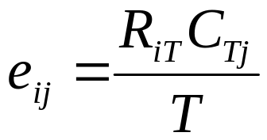
The general formula for obtaining the expected frequency of any cell
Select the test to be used to calculate, for highest expected frequency > 10 chi-square test, else Fisher‘s test

Slide 37

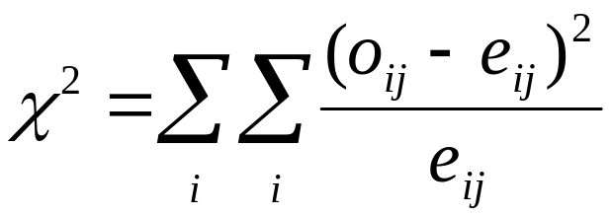

Slide 38


if the person's hair color is blond and the person uses no lotion then the person turns red
Actual
Expected

Slide 39
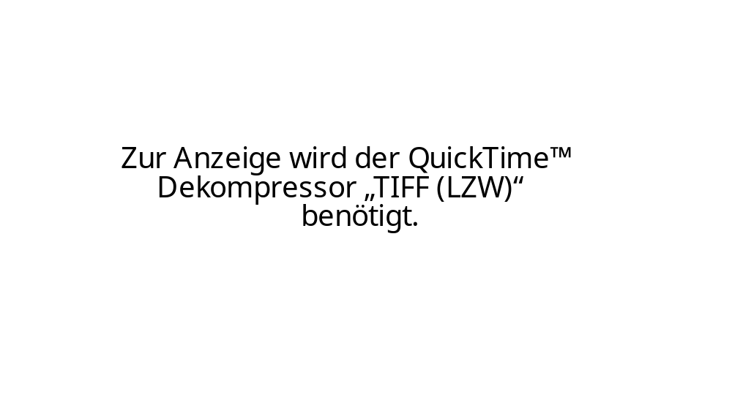

Slide 40
Sample degrees of freedom calculation:
df = (r - 1)(c - 1) = (2 - 1)(2 - 1) = 1
From the chi-square table X_{a}² = 3.84
Since X² < X_{a}² , we accept the null hypothesis of independence, H₀
Sunburn is independent from blonde hair, and thus we may eliminate this antecedent

Slide 41
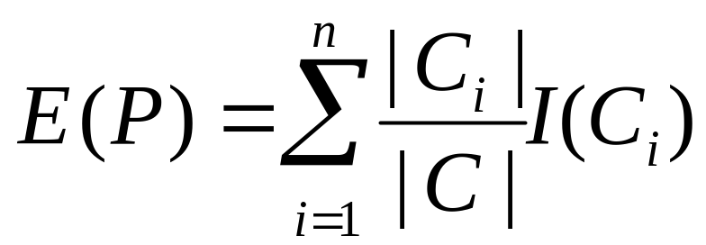
New test selection heuristic
The original test selection heuristic based on information gain proved unsatisfactory
  Favor attributes with a large number of outcomes over attributes with a smaller number
  Attributes that split the data into a large number of singelton classes (classifying patients in a medical database by their name) score well because I(C_{i}) is zero!

Slide 42
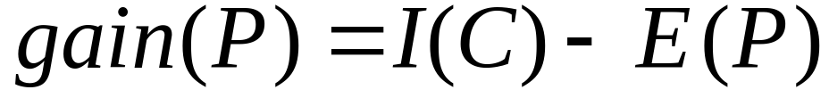
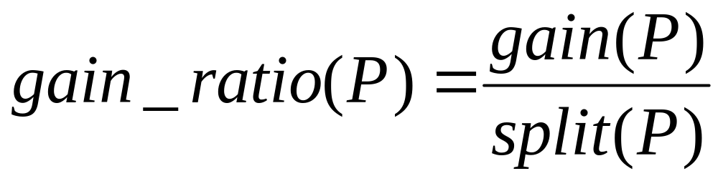
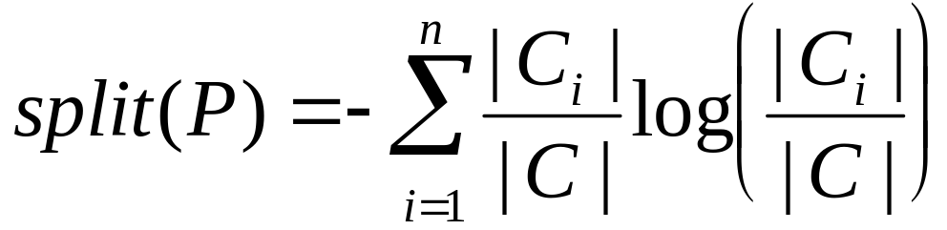
gain ratio
We use now the gain_ratio(P)

Slide 43
Other Enhancements
Allow for continuous-valued attributes
  Dynamically define new discrete-valued attributes that partition the continuous attribute value into a discrete set of intervals
Handle missing attribute values
  Assign the most common value of the attribute
  Assign probability to each of the possible values
Attribute construction
  Create new attributes based on existing ones that are sparsely represented
  This reduces fragmentation, repetition, and replication

Slide 44
Continuous Valued Attributes
Create a discrete attribute to test continuous
Temperature = 24.5⁰C
(Temperature > 20.0⁰C) = {true, false}
Where to set the threshold?
Temperatur | 15⁰C | 18⁰C | 19⁰C | 22⁰C | 24⁰C | 27⁰C
PlayTennis | No | No | Yes | Yes | Yes | No
(see paper by [Fayyad, Irani 1993]

Slide 45
Unknown Attribute Values
What is some examples missing values of an attribute A?
  Use training example anyway sort through tree
  If node n tests A, assign most common value of A among other examples sorted to node n
  Assign most common value of A among other examples with same target value
Assign probability p_{i} to each possible value v_{i} of A
  Assign fraction p_{i} of example to each descendant in tree
Classify new examples in the same fashion

Slide 46
Attributes with Cost
Consider:
Medical diagnosis : blood test costs 1000 SEK
Robotics: width_from_one_feet has cost 23 secs.
How to learn a consistent tree with low expected cost?
Replace Gain by :
Gain²(A)/Cost(A) [Tan, Schimmer 1990]
2^{Gain(A)}-1/(Cost(A)+1)^{w} w ∈[0,1] [Nunez 1988]

Slide 47
Other Attribute Selection Measures
Gini index (CART, IBM IntelligentMiner)
  All attributes are assumed continuous-valued
  Assume there exist several possible split values for each attribute
  May need other tools, such as clustering, to get the possible split values
  Can be modified for categorical attributes

Slide 48
Cross-Validation
Estimate the accuracy of a hypothesis induced by a supervised learning algorithm
Predict the accuracy of a hypothesis over future unseen instances
Select the optimal hypothesis from a given set of alternative hypotheses
  Pruning decision trees
  Model selection
  Feature selection
Combining multiple classifiers (boosting)

Slide 49
Holdout Method
Partition data set D = {(v₁,y₁),…,(v_{n},y_{n})} into training D_{t} and validation set D_{h}=D\D_{t}
Training D_{t}
Validation D\D_{t}
Problems:
makes insufficient use of data
training and validation set are correlated

Slide 50
Cross-Validation
k-fold cross-validation splits the data set D into k mutually exclusive subsets D₁,D₂,…,D_{k}
Train and test the learning algorithm k times, each time it is trained on D\D_{i} and tested on D_{i}
D₁
D₂
D₃
D₄
D₁
D₂
D₃
D₄
D₁
D₂
D₃
D₄
D₁
D₂
D₃
D₄
D₁
D₂
D₃
D₄

Slide 51
Cross-Validation
Uses all the data for training and testing
Complete k-fold cross-validation splits the dataset of size m in all (m over m/k) possible ways (choosing m/k instances out of m)
Leave n-out cross-validation sets n instances aside for testing and uses the remaining ones for training (leave one-out is equivalent to n-fold cross-validation)
In stratified cross-validation, the folds are stratified so that they contain approximately the same proportion of labels as the original data set

Slide 52
Overfiting
Reduced-Error Pruning
C4.5
  From Trees to Rules
  Contigency table (statistics)
continous/unknown attributescross-validation

Slide 53
Neural Networks
  Perceptron

